Slide 1
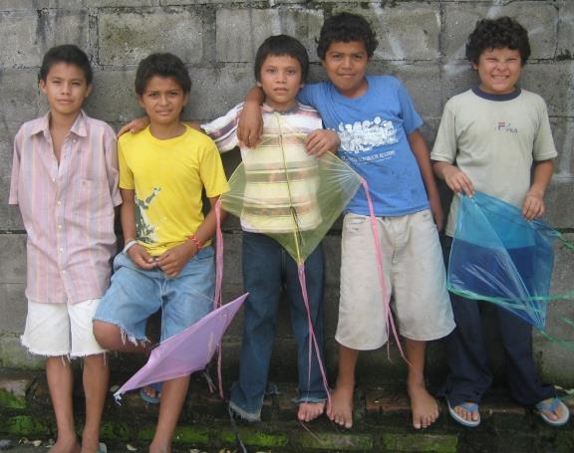
Welcome to El Salvador

Slide 2
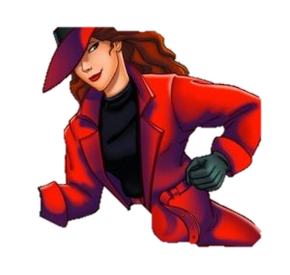
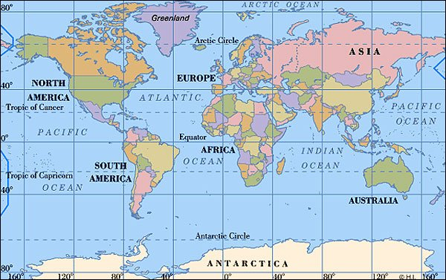
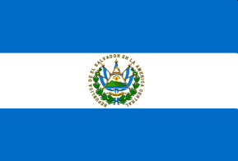
Where in the World is El Salvador?

Slide 3
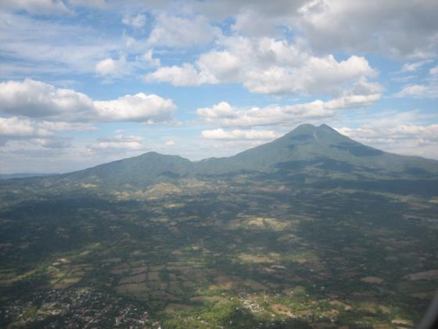
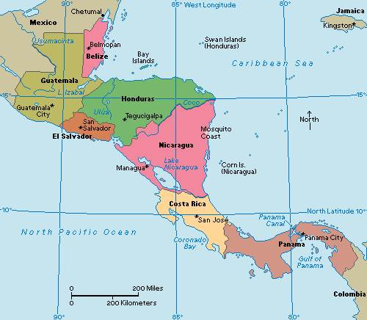
El Salvador is in Central America
El Salvador is the only CA country without an Atlantic coast

Slide 4
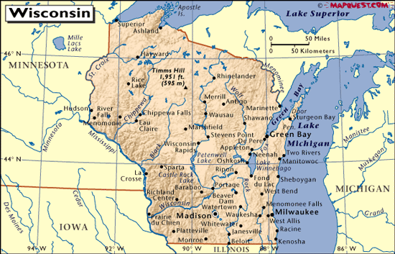
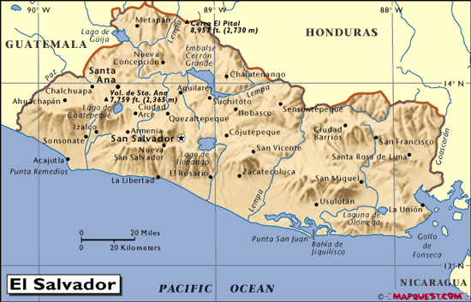
Let’s compare…

Slide 5
Some Facts
Population 6.1 million; 1.7 million in San Salvador (capital)
Size – about size of Massachusetts
Most densely populated country in the Americas
25% of population lives outside the country (mostly in US)
Government is a Democracy, with President & Legislature
Crops – coffee, sugar, livestock, corn, rice, beans
Daily wage in agriculture is $3.54; in commerce it is $6.92
1 gallon of milk at the grocery store costs $5.12
Most people speak Spanish
Approximately 50% Roman Catholic
Approximately 1% Lutheran

Slide 6
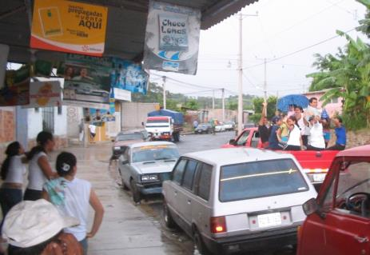
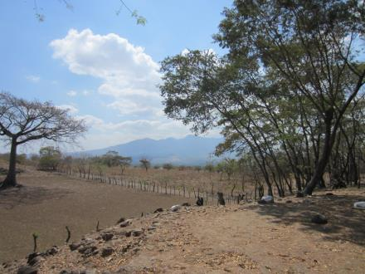
El Salvador has a rainy season and a dry season.

Slide 7
El Salvador Weather
Month | Mean Temperature |  | Mean Total Precipitation (mm)
 | Daily Minimum | Daily Maximum
Jan | 61.3 | 86.5 | 5.0
Feb | 62.2 | 86.2 | 2.0
Mar | 63.9 | 89.6 | 9.0
Apr | 66.2 | 90.0 | 36.0
May | 68.0 | 87.4 | 152.0
Jun | 67.3 | 85.1 | 292.0
Jul | 66.4 | 86.2 | 316.0
Aug | 66.7 | 86.0 | 311.0
Sep | 66.9 | 84.2 | 348.0
Oct | 66.2 | 84.4 | 217.0
Nov | 64.2 | 84.2 | 36.0
Dec | 62.4 | 85.3 | 10.0

Slide 8
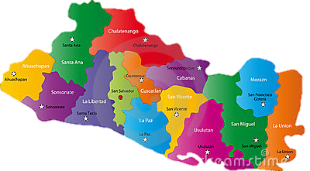

Departments of El Salvador
Los Héroes
Pasaquina

Slide 9
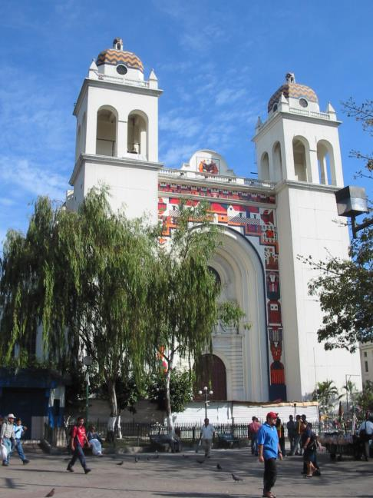
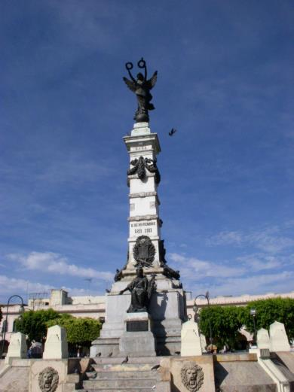
The capital of El Salvador is San Salvador

Slide 10
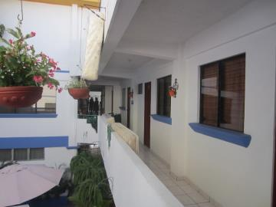
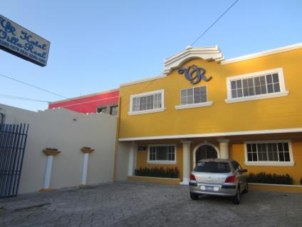
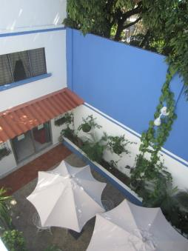
Home Base
The hotel, lots of restaurants and shopping are located in San Salvador

Slide 11
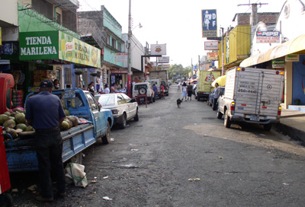
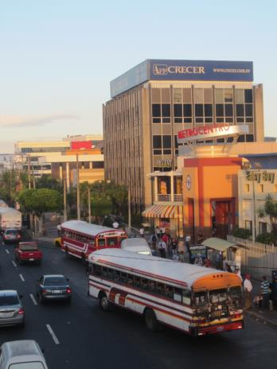
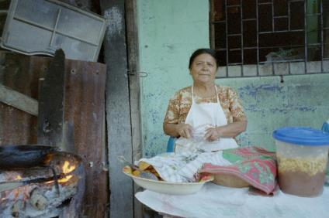
There are a wide variety of indoor and outdoor businesses – highlighting the formal and informal economies

Slide 12
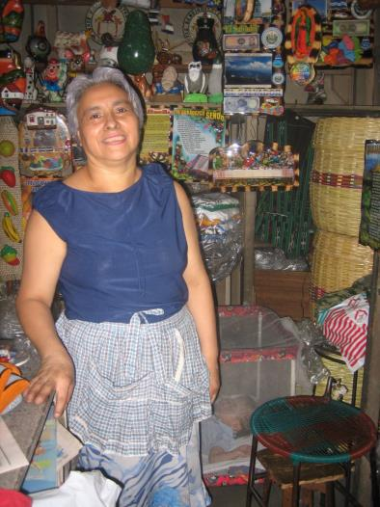
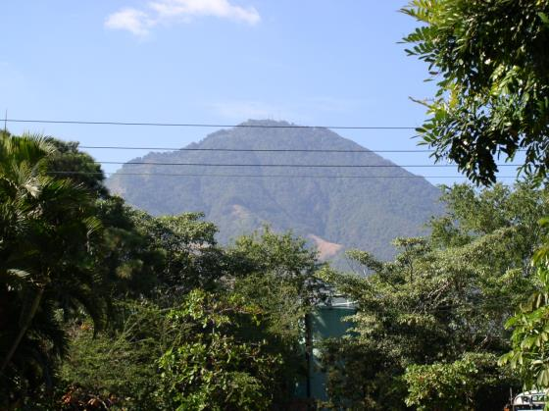
In the capital you can buy artisan crafts and you can see the San Salvador volcano.

Slide 13
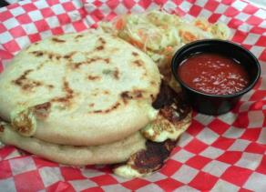
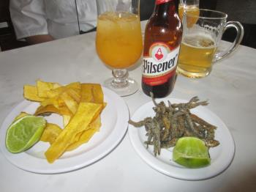
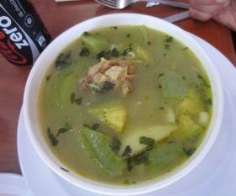
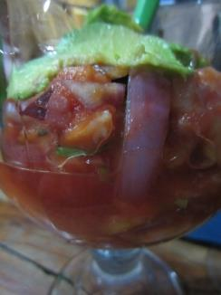
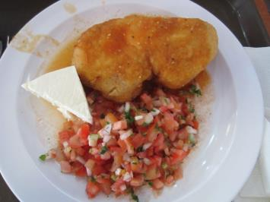
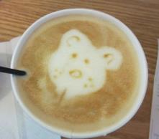
… and you can find lots of awesome new foods to sample

Slide 14
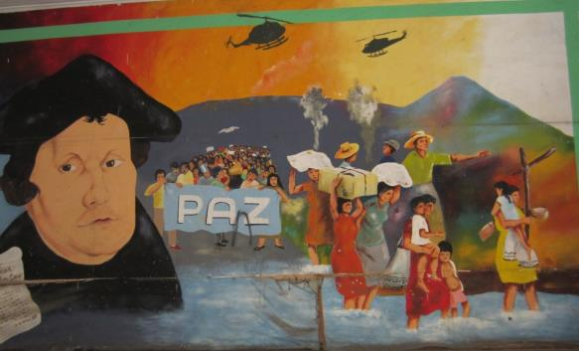
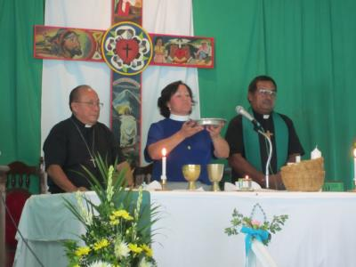
Salvadoran Lutheran Church
The Obispado, Resurrection, the Lutheran Clinic and Homeless shelter are located in San Salvador

Slide 15
Departments of El Salvador
Los Héroes
Pasaquina

Slide 16
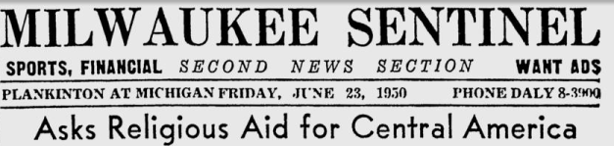
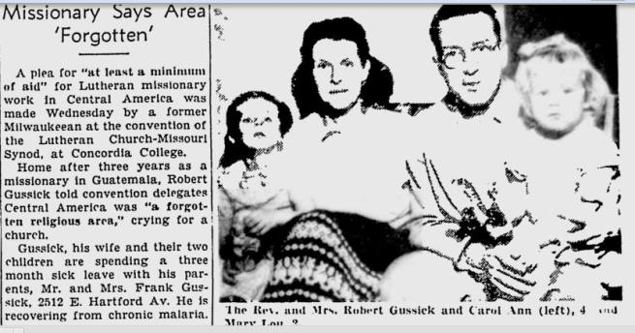
The Salvadoran Lutheran Church
It all started with Robert Gussick, a Missouri Synod Lutheran from Milwaukee, Wisconsin

Slide 17
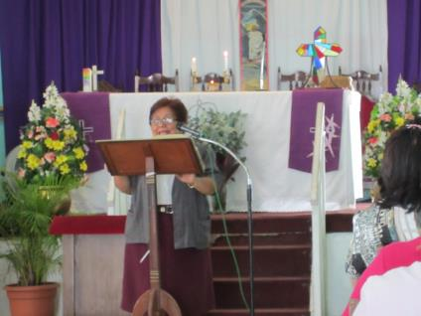
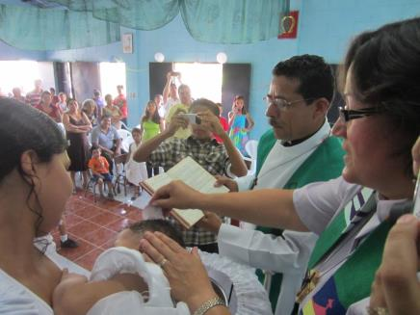
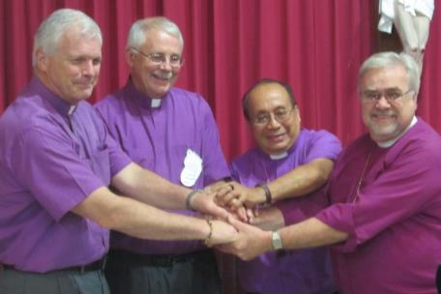

Slide 18
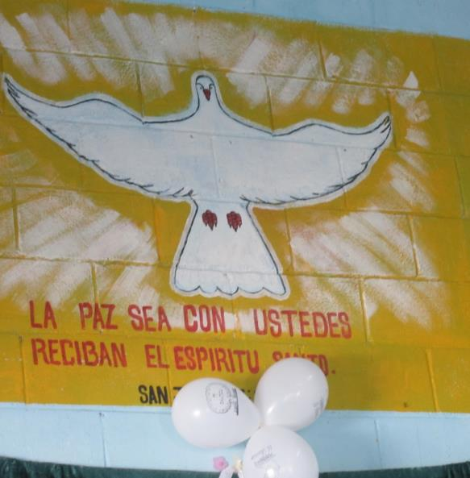
The Salvadoran Lutheran Church
now has about 70 congregations, with more than 30 ordained pastors and a big team of diaconal and lay pastors

Slide 19
German
Lutheran
Church
Swedish
Lutheran
Church
Finish
Lutheran
Church
ELC
(Canada)
Lutheran
Church of
Norway
Iglesia Luterana Salvadoreña
Salvadoran Lutheran Church
Bishop Medardo Gόmez
Greater
Milwaukee
Synod
Bishop Jeff
Individuals &
Congregations
Southern
California
Metro-
Washington DC
Synod
Sierra Pacific
Synod
ELCA Bishop Mark Hanson

Slide 20
Departments of El Salvador
Los Héroes
Pasaquina

Slide 21
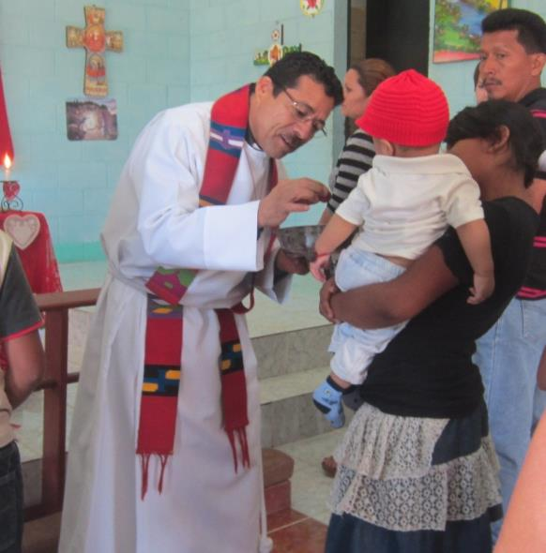
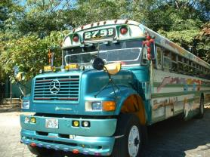
Los Héroes
is located just north of San Salvador – 45 minutes by car and 2 ½ hours on 2 or 3 buses

Slide 22
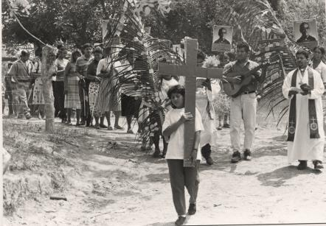
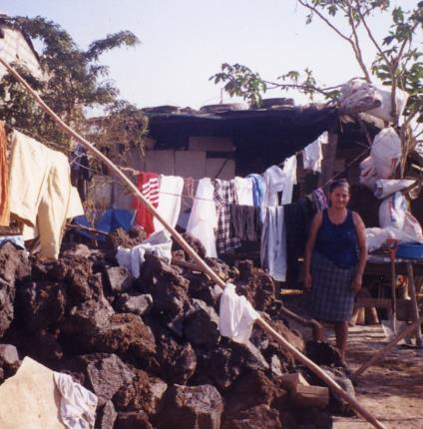
Los Héroes
was founded in 1996 as a resettlement for IDP community after the Salvadoran Civil War

Slide 23
Communion of Lutheran Churches
In Central America (CILCA)
Costa Rica,
Nicaragua
Honduras,
Guatemala
Sister Churches
Companion Synods
Los
Héroes
St.
John’s
Salvadoran
Lutheran
Church (ILS)
Los Héroes
de la Fe
ELCA
Greater Milwaukee Synod
Lutheran World Federation (FLM)
St. John’s

Slide 24
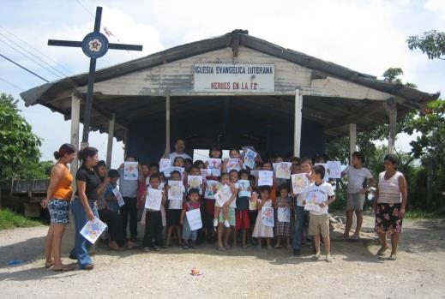
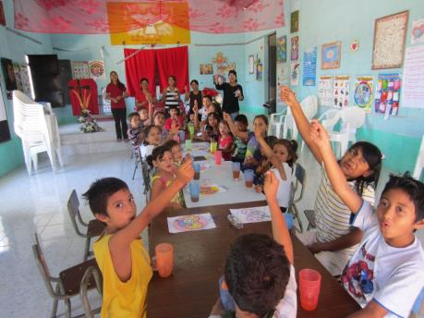
Sunday School

Slide 25
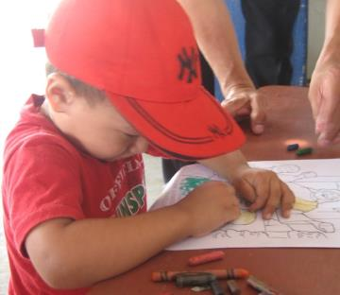
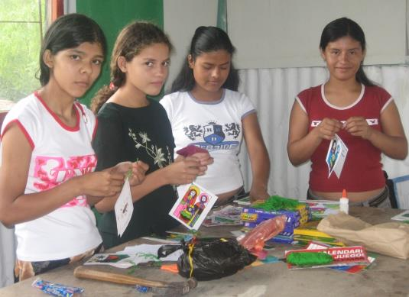
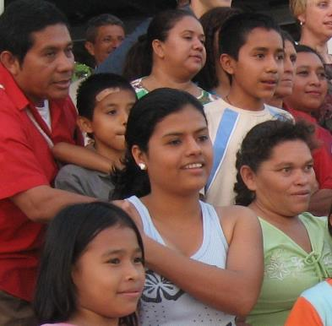
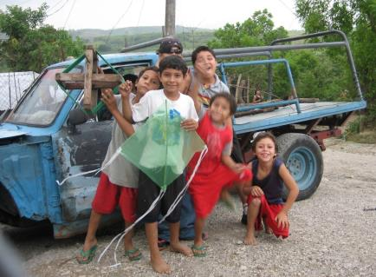

Slide 26
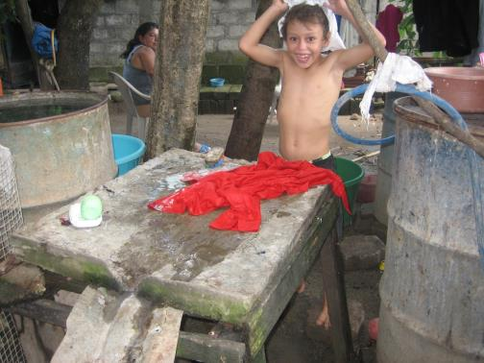
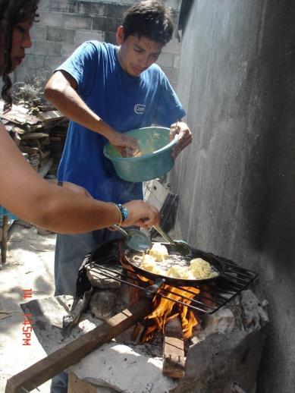
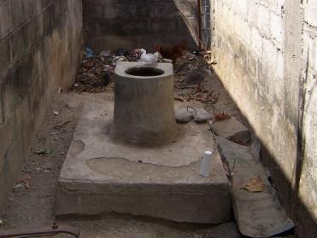

Slide 27
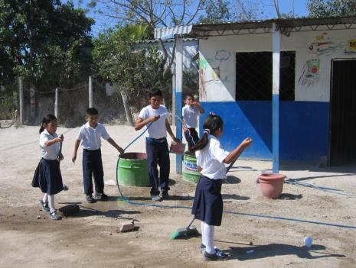
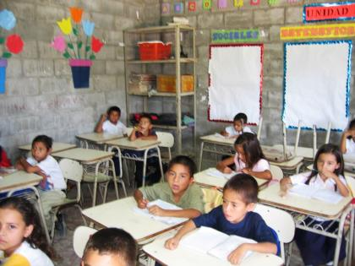

Los Héroes School

Slide 28


Entrepreneurship

Slide 29


Chores… and a small business.

Slide 30





Slide 31




Slide 32


Slide 33





Slide 34



When you order fish in El Salvador…

